Slide 1
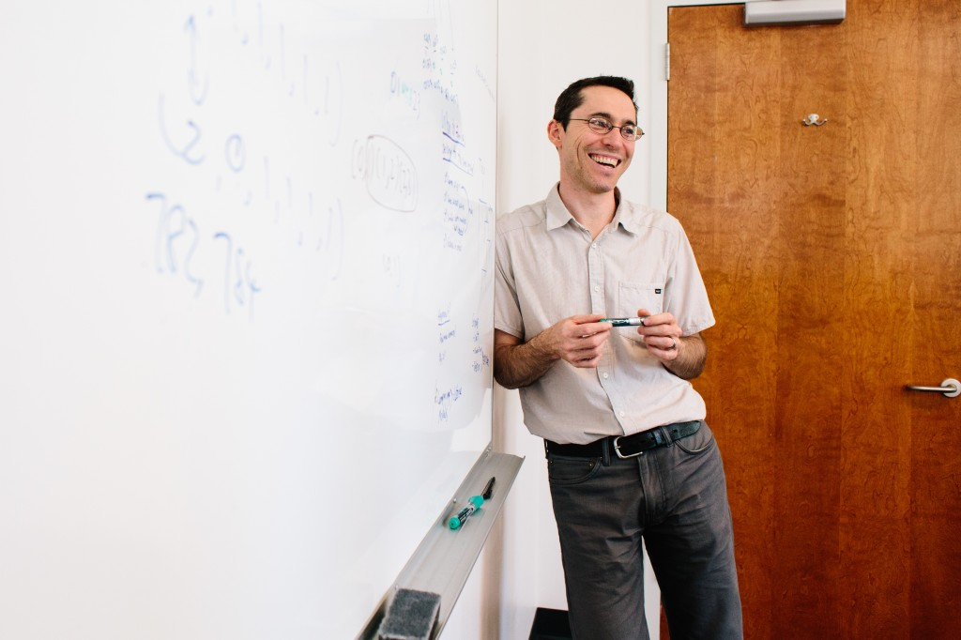

Computing + Biology = Discovery
In the freshman year!
Ran “Ron” Libeskind-Hadas, Department of Computer Science
Eliot Bush, Department of Biology
Harvey Mudd College

Slide 2
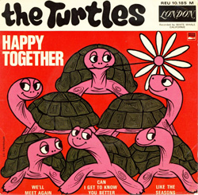
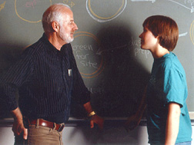
Harvey Mudd College: Biology + Computer Science So happy together since 1977
Bill Purves

Slide 3
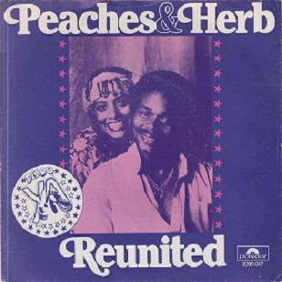
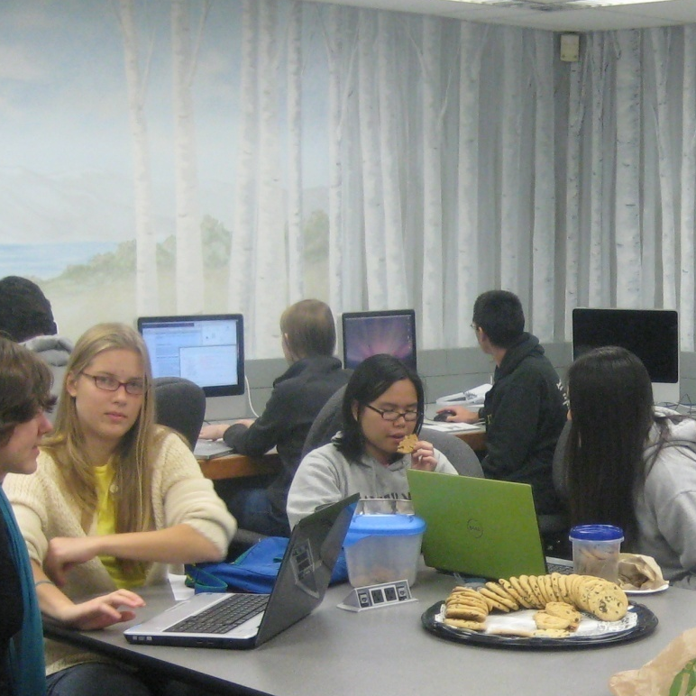
Harvey Mudd College: Biology + Computer Science CS 5 Green reunites Biology and CS!
CS 5 Green Friday lab session

Slide 4
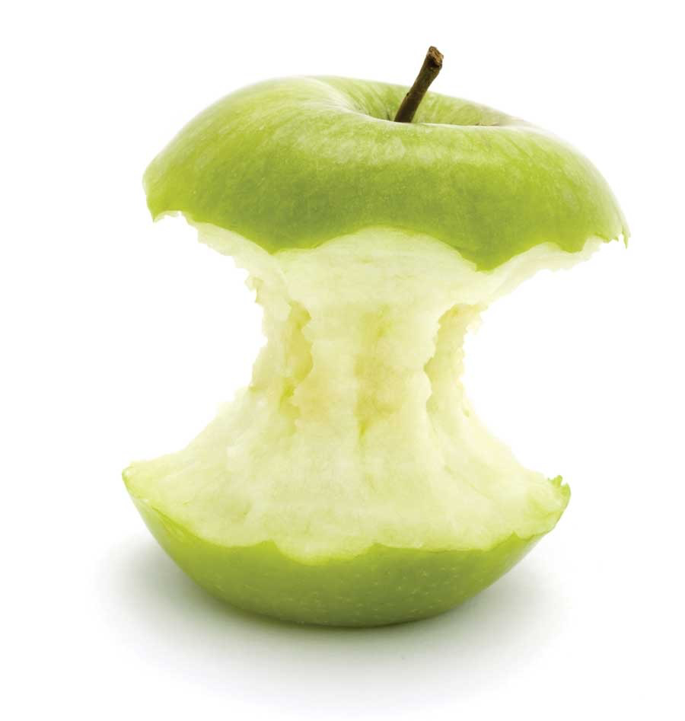
The Harvey Mudd Core Curriculum
Freshman Fall
Computer Science
Calculus + ProbStat
Physics + Writing
Chemistry + lab
Elective
Freshman Spring
Biology
Linear + DE’s
Mechanics + lab
Chemistry
Humanities
Elective
Sophomore Fall
Systems Engineering
Multivariable + Linear/DE’s II
Electricity and Magnetism
Multidisciplinary lab
14 week semester

Slide 5
Computer Science 5
Service (programming!)
Imperative, recursive, and object-oriented programming
Design, test, and debug
75-150 lines of programming each week
Big Ideas
Algorithm design
Efficiency/complexity
Computability
How computers work
Capstone project (with some choice!)

Slide 6
The Harvey Mudd Core Curriculum
Freshman Fall
Computer Science
Calculus + ProbStat
Physics + Writing
Chemistry + lab
Elective
Freshman Spring
Biology
Linear + DE’s
Mechanics + lab
Chemistry
Humanities
Elective
Sophomore Fall
Systems Engineering
Multivariable + Linear/DE’s II
Electricity and Magnetism
Multidisciplinary lab
CS 5 “Gold” (no prior experience)
CS 5 “Green” (no prior experience)
CS 5 “Black” (AP-level background)
CS 42 (crazy amounts of background)

Slide 7
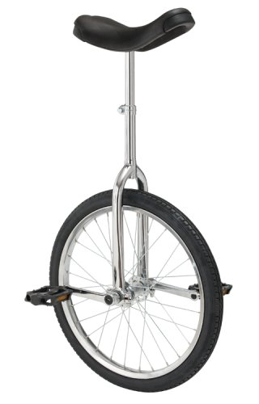
CS 5 Green Objectives
Motivate computing via compelling questions from Biology
Teach CS 5 core content with emphasis on building tools to make discoveries!
Students write everything “from scratch” (no magic!)
Co-taught by Biology and CS faculty members
50 students each fall
Half HMC first-year students
Half Pitzer, CMC, Pomona, Scripps life sciences students

Slide 8
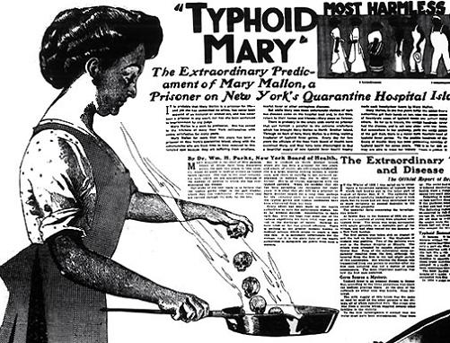
Unit 1
3 weeks
Python versus Pathogens!
Simple functions using for and while loops to identify pathogenicity islands and ORFs
Use randomization to identify putative protein-coding genes
BLAST found genes to learn about them

Slide 9
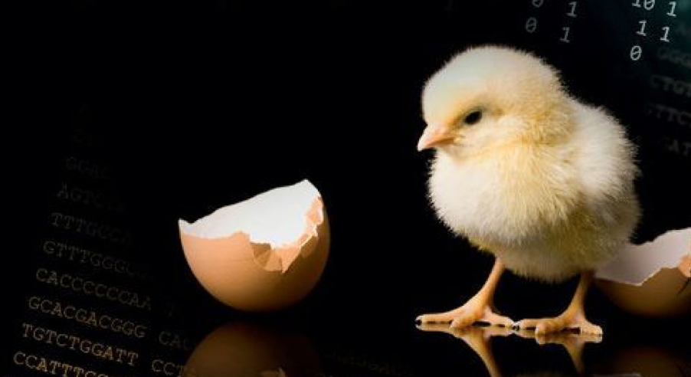
Unit 2
3 weeks
Are the mammalian and avian sex chromosomes homologous?
Introduce recursion to compute edit distance, sequence alignments, and related measures
Dynamic programming to make this efficient for long sequences
Design and test programs with multiple functions to solve a “large problem”

Slide 10
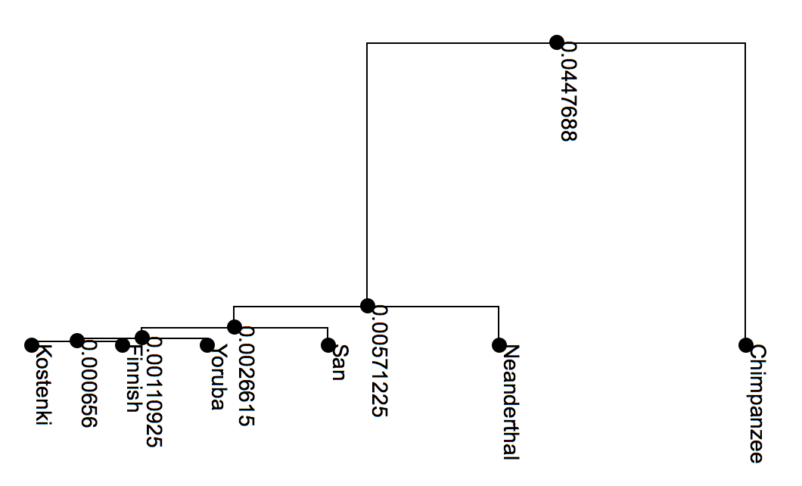
Unit 3
3 weeks
The Evolution of Modern Humans
Algorithms for inferring phylogenetic trees
Recursive algorithms for rendering and analyzing phylogenetic trees

Slide 11
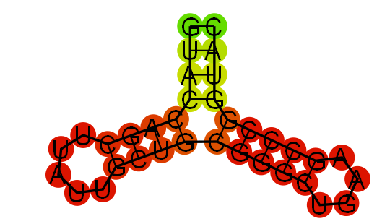
RNA Folding
1 week
Implement Nussinov RNA folding algorithm
Augment the algorithm to compute and display the fold
Analyze HIV pol gene to find areas of high secondary structure
Use a randomization experiment to compute empirical p-value

Slide 12
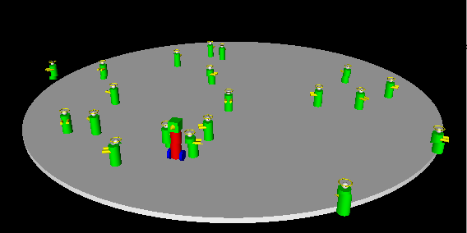
Breadth
Object-oriented design
How computers work
What are the limits of what computers can do?

Slide 13
Capstone Project
Inferring gene regulatory networks using maximum likelihood
Designing primers to “fingerprint” bacterial strains
Object-oriented genetic algorithms for robot control

Slide 14
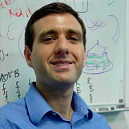
Gene Regulatory Networks using Maximum Likelihood
Binary expression data
Regulatory network hypothesis
1
1
0
0
1
1
1
0
1
0
1
0
1
1
1
1
0
4
Pr{ | }
= Pr{ }
x Pr{ | }
x Pr{ | ,
}
x Pr{ | }
0
0
1
0
0
0
0
1
2
3
0
0
0
0
0
1
0
1
1
1
0
0
1
1
1
0
0
1
0
1
1
1
1
0
1
1
0
0
1
1
1
0
0
0
1
0
0
0
0
1
1
1
0
0
1
1
1
0
0
1
0
1
1
1
1
0
0
0
0
0
0
1
0
1
0
0
1
0
0
0
0
1
Courtesy of Prof. Russell Schwartz

Slide 15
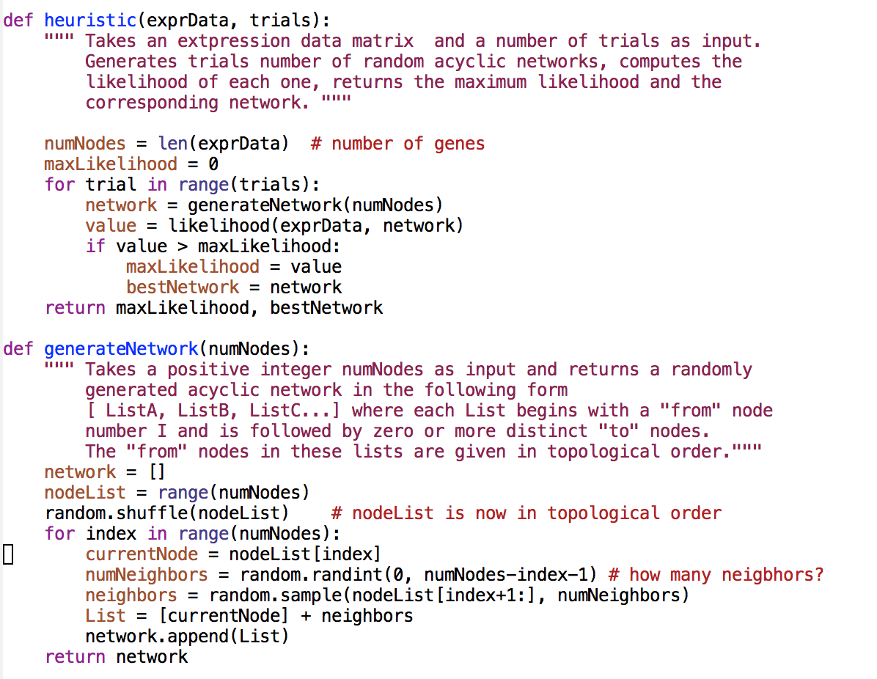
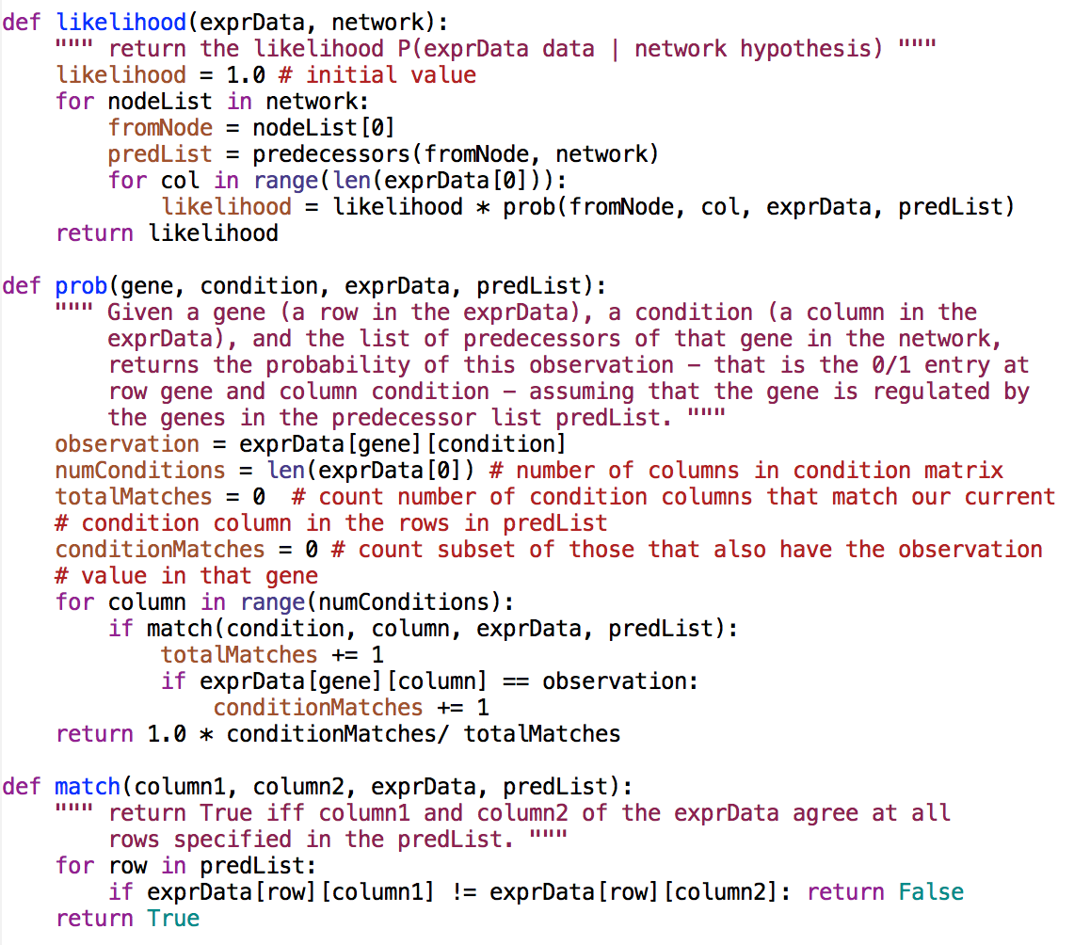
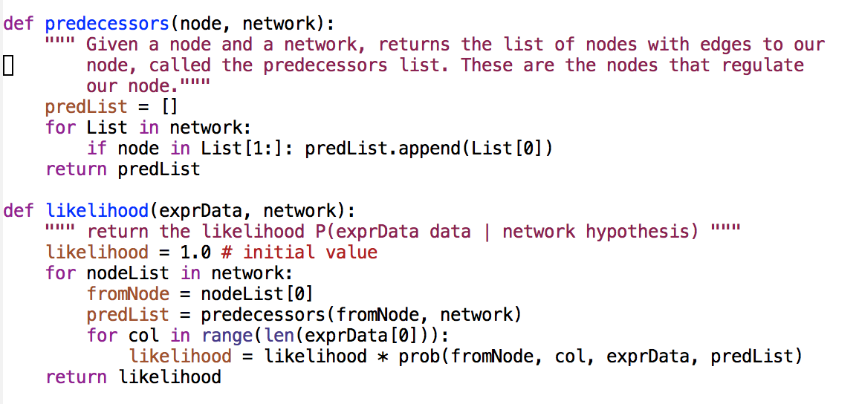

Slide 16
Data and Outcomes… (Fall 2014)
Course evaluations on 1-7 Likert scale (std. dev about 0.8)
Stimulated interested Learned a lot
All HMC 5.6 5.9
CS 5 Green 6.5 6.8
Gender distribution
HMC: 46% women
CS 5 Green: 75% women
Anecdotal evidence that students apply what they’ve learned in other courses!
Performance in next CS course: No statistical difference between sections
Also, about 50% of students from other Claremont Colleges

Slide 17
The Harvey Mudd Core Curriculum
Freshman Fall
Computer Science
Calculus + ProbStat
Physics + Writing
Chemistry + lab
Elective
Freshman Spring
Biology
Linear + DE’s
Mechanics + lab
Chemistry
Humanities
Elective
Sophomore Fall
Systems Engineering
Multivariable + Linear/DE’s II
Electricity and Magnetism
Multidisciplinary lab

Slide 18
Core Biology Course Context
Taken in spring semester of first year
Assumes no biology background
Students have had computer science, probability and statistics

Slide 19
Core Biology Course Objectives
Solve biological problems using skills from throughout the HMC core
Learn foundational concepts from molecular genetics and evolution
Gain an appreciation of the promise and possibilities of 21st century biology

Slide 20
Genes, Genomes and Human Health
Evolution, trees, and HIV
Why do some strains of Vibrio cause cholera and others don’t?
Receptors, signals, and immunity
Disease and selection in the human genome

Slide 21
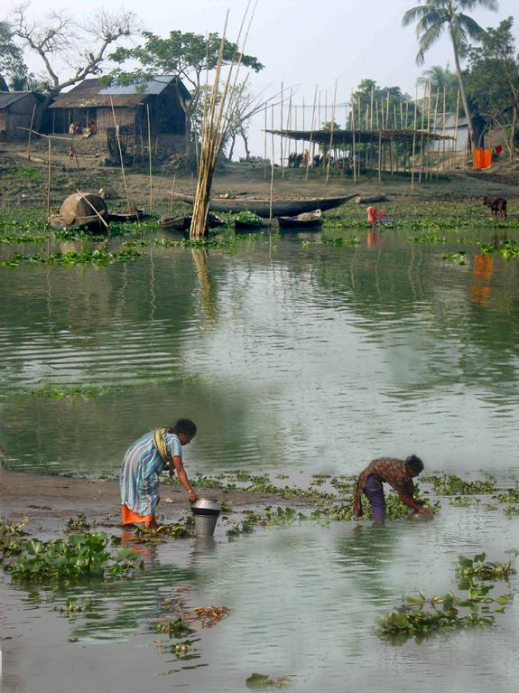
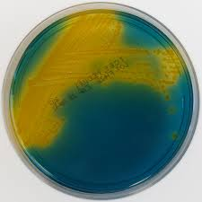
Question: why do some strains of Vibrio cause cholera and others don’t?
http://www.flickr.com/photos/54976525@N08/7748440602
Mike Emch (University of North Carolina) and David Bay (University of Michigan)

Slide 22
A three week “methods” unit
Sequencing
Assembly
Gene finding
Alignment
Non-pathogenic strains
Pathogenic (N16961) strain
2740_80
PS15
vs.

Slide 23
Building a probabilistic gene finder
Training data: E. coli open reading frames
Gene
Not gene
Calculate conditional probabilities on codons
AAAAAA: 0.048 AAAAAC: 0.021 AAAAAG: 0.013...
AACAAA: 0.029 AACAAC: 0.021 AACAAG: 0.023...
AAGAAA: 0.057 AAGAAC: 0.017 AAGAAG: 0.033...
AATAAA: 0.049 AATAAC: 0.016 AATAAG: 0.016...
ACAAAA: 0.022 ACAAAC: 0.015 ACAAAG: 0.011...
.
.
.
AAAAAA: 0.025 AAAAAC: 0.026 AAAAAG: 0.026...
AACAAA: 0.024 AACAAC: 0.023 AACAAG: 0.013...
AAGAAA: 0.024 AAGAAC: 0.020 AAGAAG: 0.025...
AATAAA: 0.027 AATAAC: 0.023 AATAAG: 0.009...
ACAAAA: 0.034 ACAAAC: 0.033 ACAAAG: 0.027...
.
.
.

Slide 24
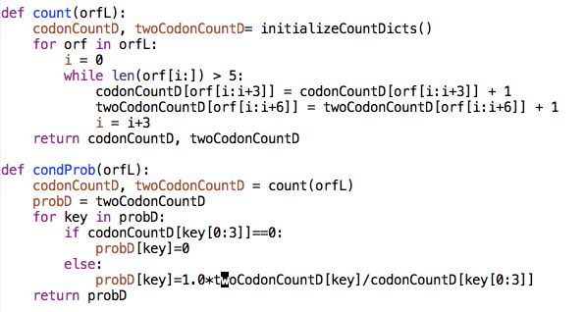
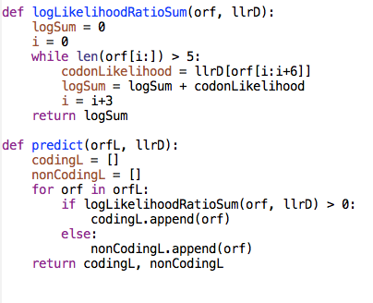
Example student solution
Notes:
[Code by Juliette Forman, HMC 2018]

Slide 25
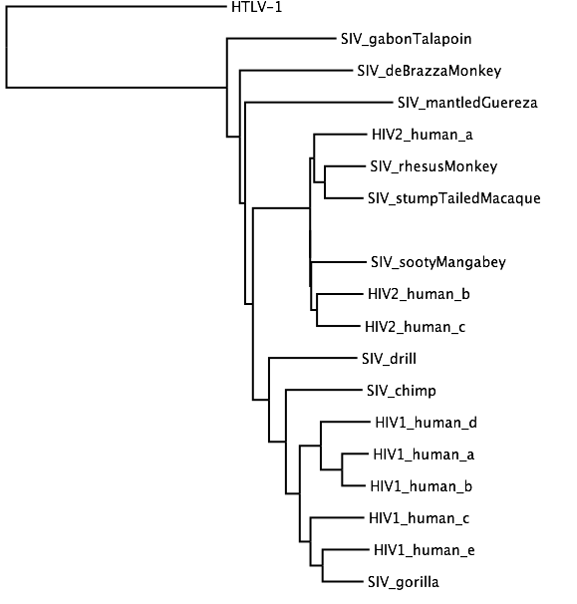
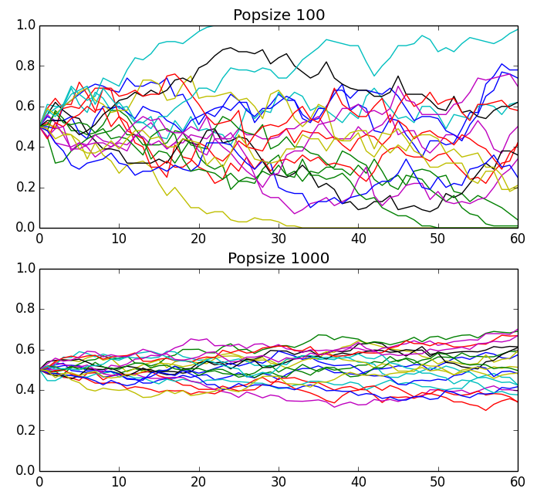
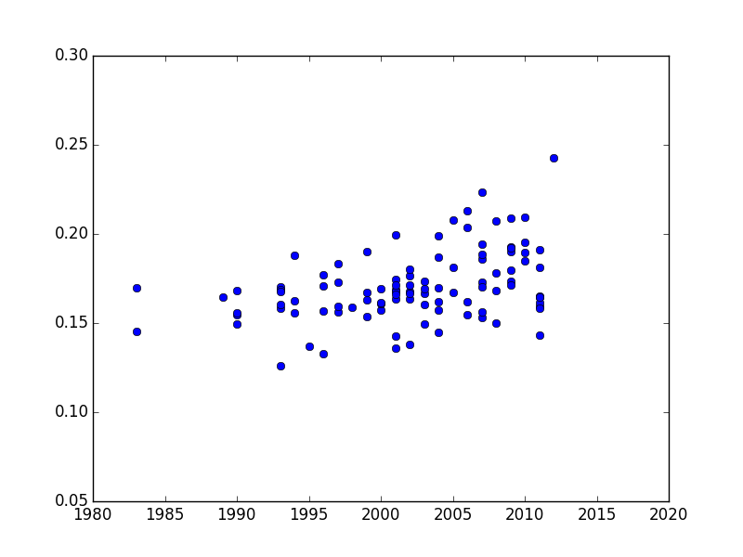
HIV Evolution Assignments
Build a population genetics simulator
Implement neighbor-joining and use it to reconstruct an HIV/SIV tree
Estimate when HIV group M entered the human population
Branch length
Collection date
Generation

Slide 26
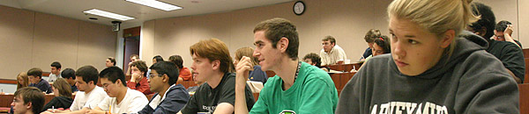
Reflections on the Integration of Biology and CS
Students see “Science without Borders”
Horizontal integration and reinforcement of material
Builds bridges between departments
Research
New courses and curricula
Notes:
I’m not attached to this title…

Slide 27
Mathematical and Computational Biology Major
HMC core curriculum
Introductory sequence
Discrete math
Biostatistics
Intro to Mathematical and Computational Biology
Introductory Biology Lab
Biology Foundations: 2 courses, 1 seminar, 1 lab
Mathematical and computational foundations: 5 courses, many choices
1 elective
Thesis or other capstone
Colloquium

Slide 28
Resources
CS 5 Green course website: www.cs.hmc.edu/cs5green
Master set of homework problems: tinyurl.com/cs5greenHW
Biology 52: https://sites.google.com/a/g.hmc.edu/bio52/

Slide 29
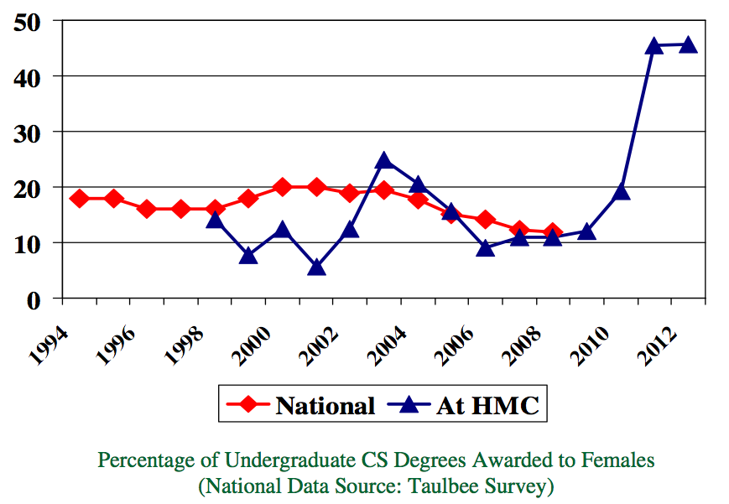

Undergraduate Women in CS by Graduation Year
45%
14%

